Slide 1
DIGITHON’21
TEAM : Innovation Giants
THEME : Video analytics - Lost And Found Live (LOFLI)

Slide 2

Team Members
CHAUDHARY, VISHAL
GARG, GAURAV
PRASAD, RAGHAVENDRA
SHUKLA, VIPULENDRA
https://www.peoplematters.in

Slide 3
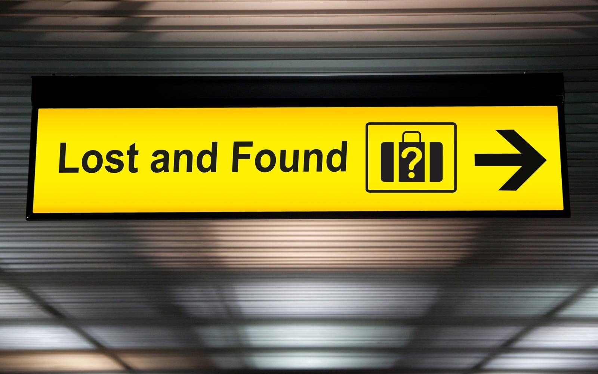
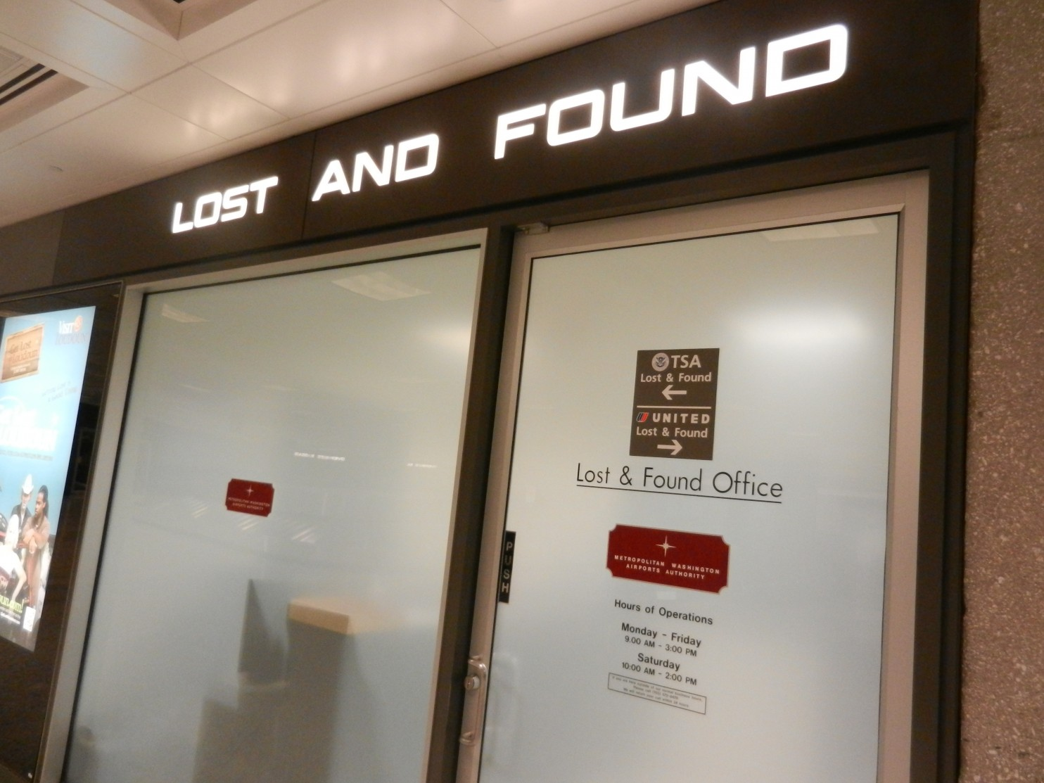
Lost and Found at Airports
Real World Problem

Slide 4
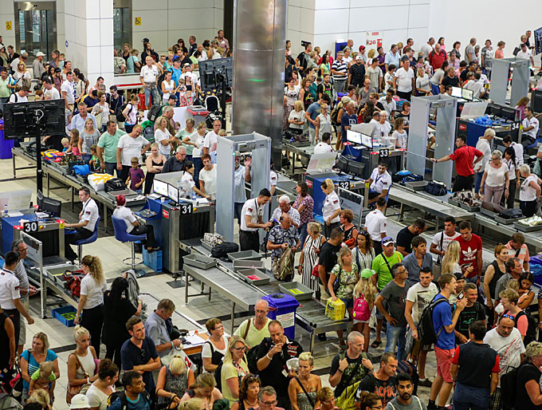

Problem Analysis
Based on the data from Airport Authority of India :
(Dec’19 – Jan’21)
In Domestic airports, 6,500+ lost items are identified
In International airports, 400+ lost items are identified
Data indicates that a significant number of passengers have lost items at the airport
Claiming the lost item from airport can be a cumbersome process, sometimes too impractical.

Slide 5
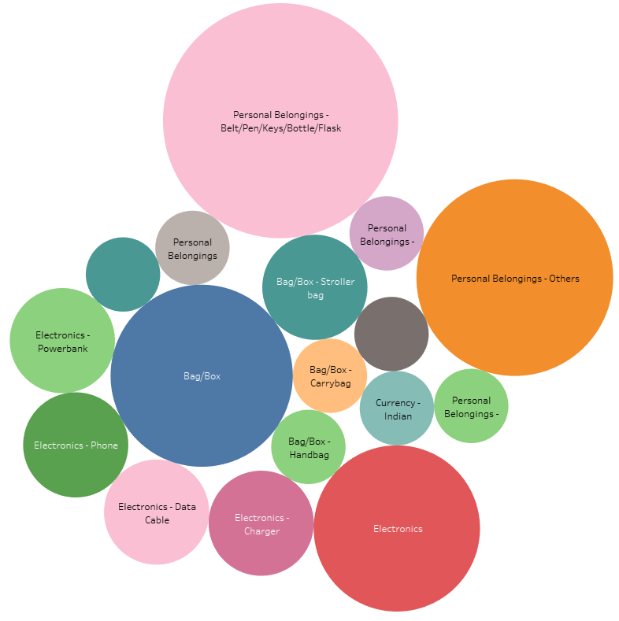
Data Analysis - Ahmedabad

Slide 6
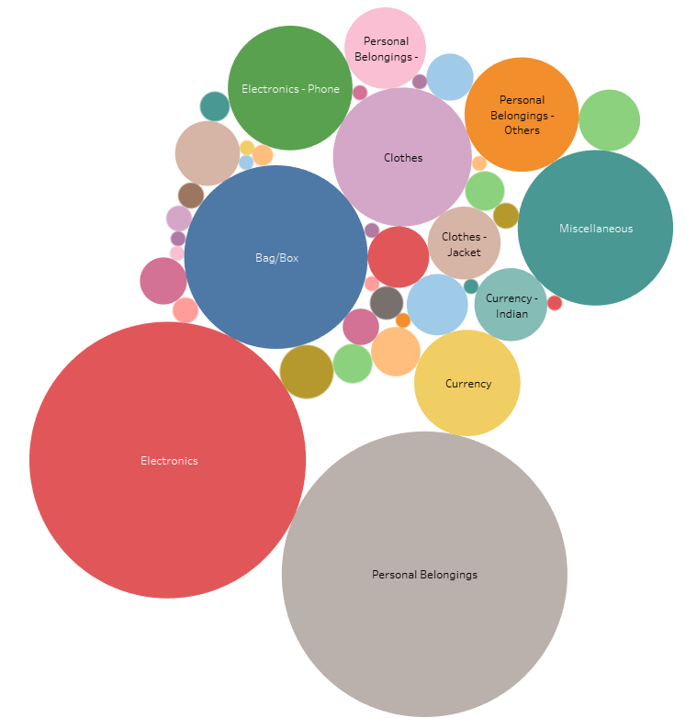
Data Analysis - Kolkata

Slide 7
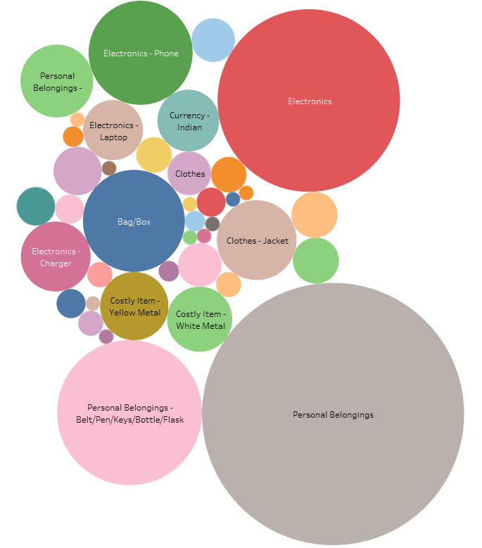
Data Analysis - Chennai

Slide 8
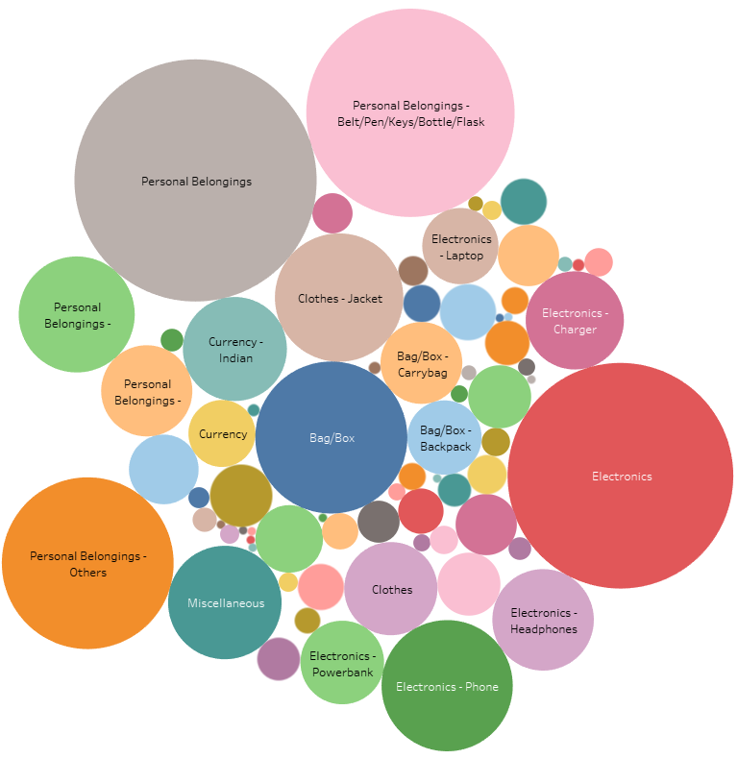
Data Analysis - India

Slide 9
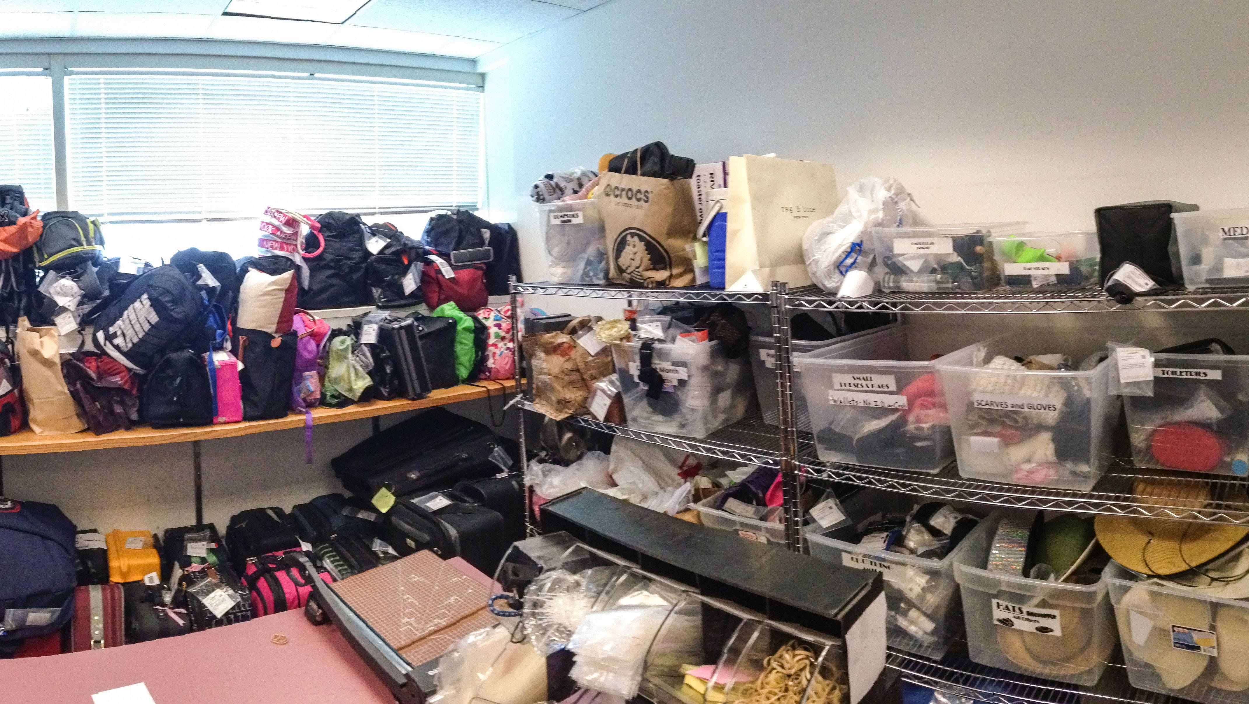
Lost And Found Stock Room at Airports !!

Slide 10
Data Analysis
After analyzing the available data, we observed the following patterns:
Majority of the lost items are electronics, bags, apparels, currency and personal belongings.
Sometimes there are minor changes in the pattern depending on the location of airports.
The most prone situation when the passengers are losing their belongings is during the security screening process, when the personal items must be kept in a tray (e.g., jacket, laptop, cell phone, watches, etc. ) and they forget to collect their items.

Slide 11
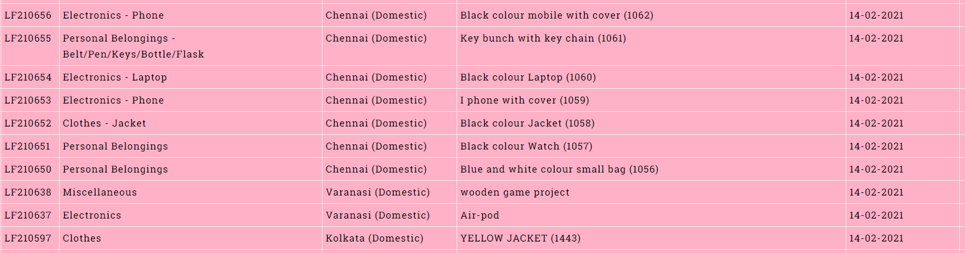
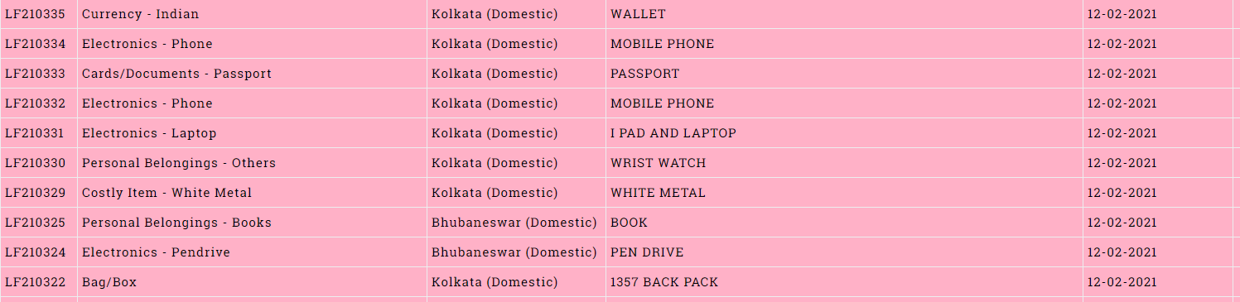
Data from Airport Authority, India (https://www.aai.aero/en/lost-found)

Slide 12
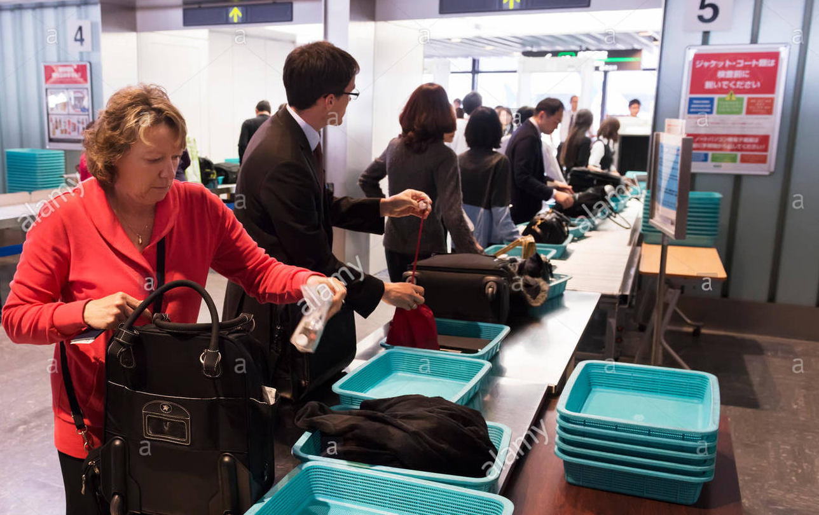
Problem statement
PHASE - 1
How to detect objects of interest?
PHASE – 2
How to tag the objects of interests to a specific passenger?
PHASE – 3
How to identify the behavior of passenger forgetting an item?
PHASE - 4
How to alert the passenger?

Slide 13

Increase Business Value
A value-added feature that can be supplemented with the existing Smiths Detection products at the airports
Extra edge to our product with the additional feature for increasing revenue and market competency
Reducing the overhead costs and documentation for the customers
Increase customer satisfaction

Slide 14
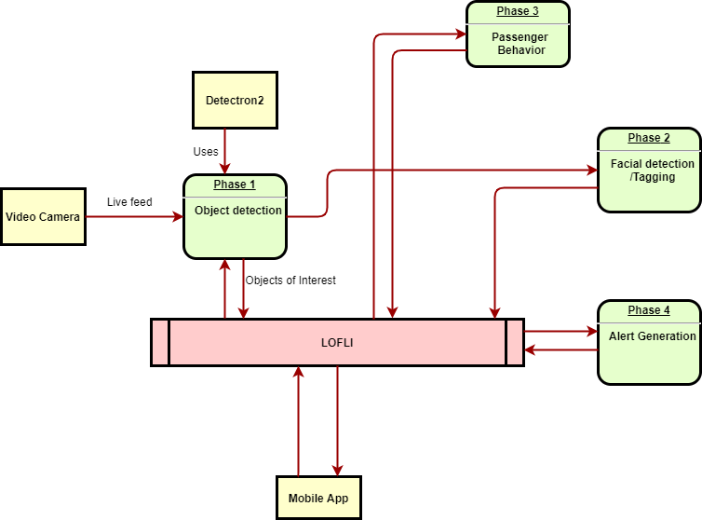
Basic Architecture of LOFLI

Slide 15

Proposed Solution [Phase1]
How to detect objects of interest?
We used Facebook AI Research's next generation software system - detectron2 along with coco dataset
We experimented with object detection using built in web camera in Google Colab

Slide 16
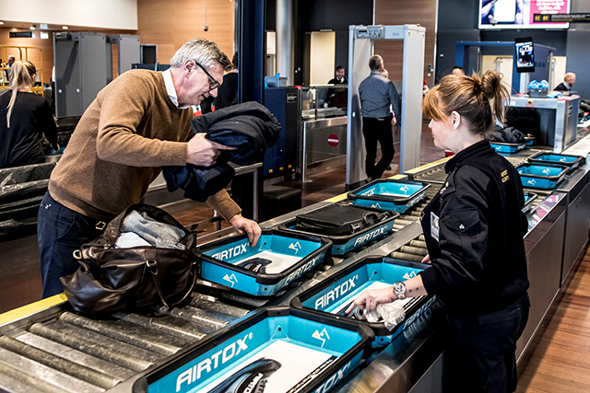
Proposed Solution [Phase2]
How to tag the objects of interest to a specific passenger?
Use facial detection and auto enroll the passenger's facial features
Link detected objects of interest to passenger's facial features
Tag the objects of interest to the passenger's facial data
Monitor the tray at other end of the Xray screening machine
Check for missing items based on certain threshold

Slide 17
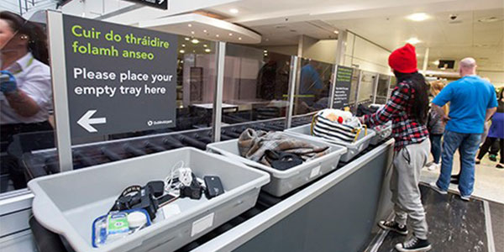
Proposed Solution [Phase3]
How to identify the behavior of passenger forgetting an item?
Assume all items are in a tray
Detect the objects in the tray
Tag the objects of interest to the passenger
Monitor the tray at other end of the Xray screening machine
Check for missing items based on certain threshold

Slide 18
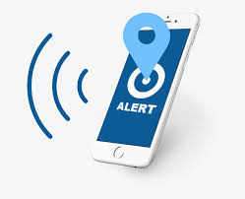
Proposed Solution [Phase4]
How to alert the passenger?
Develop a mobile application
Let the users enroll their face and subscribe for notifications
When there is a facial match and detection of anomalies related to misplaced object, trigger an alert

Slide 19
UI/ Video
Current status [PHASE1~PHASE3]
Primarily working on object detection using web camera and detectron2 using mask_rcnn_R_50_FPN model
Integrated python face-recognition package for facial recognition and tagging
Source code and presentation is pushed to bitbucket repository

Slide 20
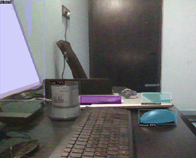
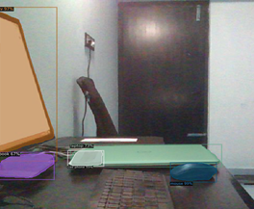
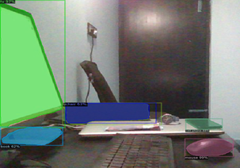
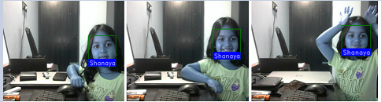
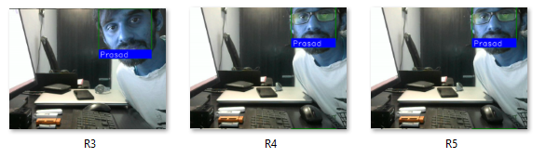
UI/ Video
Sample object detection outputs ( laptop, cellphone, mouse, cup etc.) in real time is shown below
Sample facial recognition outputs

Slide 21
Impact of Proposed Solution
We have collected the lost and found data for India and we believe that this problem is universal and applicable for any airport
We believe that recovering a lost item from the airport may involve a lengthy process
Sometimes it may not be practical to reach out to the airport and collect and recover the item
Passengers are losing different kinds of items. Even if we focus on high value items, we can address this problem up to certain extent.
Based on our POC, it is technically feasible to implement this unique solution using deep learning-based object detection ,facial recognition, facial tagging and statistical analysis followed by intelligent mobile alerts

Slide 22
References
Resource | Link
Airport Authority of India - LOST & FOUND CATALOGUE | https://www.aai.aero/en/lost-found/item-list
Detectron2 | https://github.com/facebookresearch/detectron2
Face Recognition | https://pypi.org/project/face-recognition
Google Colab | https://colab.research.google.com
Video Analytics | https://www.sciencedirect.com/topics/computer-science/video-analytics

Slide 23

Thank you

